Slide 1
Welcome to the 14th Annual We Can’t Wait Conference on Early Childhood Mental Health Re-imagining Prevention & Early Intervention in Communities of Hope
Ali Freedman, PsyD, MBA
Conference Co-Chair
September 28, 2023

Slide 2
Welcome and Welcome Back
Good Morning!
14th Annual meeting
1st in person since 2019
1st Hybrid Event
Please post your Tech Questions in the Chat
Please post Content Questions in the Q & A
Please write your questions on note cards
Funding Partners
Speakers
UCSD Office of Continuing Medical Education
We Can’t Wait Committee (Part 1)

Slide 3
Housekeeping, Bits and Bobs
Networking Reception 5-7PM tonight, Lookout Point at Town & Country
Parking – validation at registration
Name Tags and Toys
Conference Program – Page 5 Virtual Lobby, Registration, & Email “Final Instructions”
CME/CE – Pages 5 and 10 and Virtual Lobby
Evaluations – Page 5 and the Virtual Lobby
CA Personnel Competencies in Infant-Family and Early Childhood Mental Health – Page 5 or 40 in the program
Bookstore is Back! – Visit the Pacific Foyer
Exhibitors
When in doubt… Virtual Lobby and Handouts Tiles or Registration Table
Temperature, Restrooms, Cell Phones/Ice Cream Trucks, and THANK YOU!

Slide 4
Synergistic Sisters
4th Birth of Brilliance Conference
LEARN into BoB February 29, 2024
LOVE & LEAN into BoB’s Cultural Fair March 1, 2024
Registration opens 12/1 birthofbrilliance@gmail.com
9th Critical Issues in Child and Adolescent Mental Health – CICAMH
Coming at you HYBRID style Friday April 26, 2004
University of San Diego https://cicamh.com
15th We Can’t Wait Conference on ECMH September 2024!
Format and details TBD

Slide 5
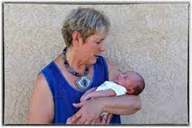
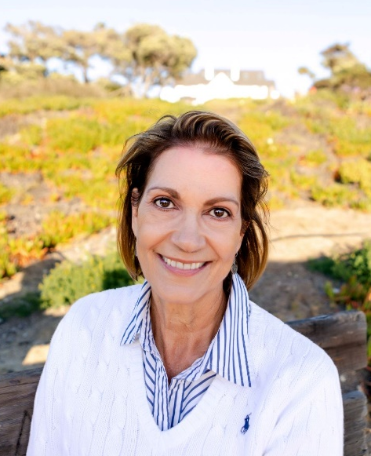
Our Committee: Remembrance & Gratitude
In Loving Memory and Honor of Deb Stolz, one of the Founding
Members of the We Can’t Wait Conference, Mother, Grandmother,
Teacher, Mentor, Friend, Resource/Foster Mom, Advocate, F.A.B.
A-1 The Deb Stolz Memorial Breakout Session Disrupted Attachment: What Can Happen and What Can Be Done?
Chris Muecke
(Breathe, Ali…)
Invitation to join a collective moment of silence after brief remarks
Notes:
NEXT slide

Slide 6
Christine Lynch Muecke
71 years of smiles
Notes:
Chris Muecke was one of the founding members of the WCW ECMH Conference. In just this capacity, she helped reach well over 5000 attendees in 14 years. Thinking about her smile, exuberance, and contagious enthusiasm, in a lot of ways she embodied what is wonderful about our children. And then, in some ways, she saw the future. She knew not only that the best interventions and successes could be achieved by supporting young children and their families, but she committed over these last decades to workforce development so that we would have experts trained in this field for generations to come. Chris left her bright and shiny, hopeful, passionate mark on our kids, on our community, and on our hearts. She will be honored in perpetuity at the We Can’t Wait Conference with a scholarship for exceptional and dedicated students in the field. I can see her smiling at the thought of it.

Slide 7
A Legacy at Home & in the Community
A Beautiful Family
Jackson
Lauren, Meredith, Alexa, Josh, & Alyssa
Gavin, Grayson, Aven, & Nash
1st Annual Chris Muecke WCW Scholars
Nikki Lane
Zynthia Manalansan
Notes:
Nikki Lane has been a committed student in CFD and a delight to work with. She seeks ways to use her leadership skills in service to others. She is continually taking on roles of responsibility and is a pleasure to work with.
Zynthia Manalansan has been continually overcoming difficulties and inspires us with her capacity to do hard things. She shows determination, humility, and grace amidst pressure. We are grateful to have her in our program!

Slide 8
Gather and re-center
Notes:
https://www.ted.com/talks/molly_wright_how_every_child_can_thrive_by_five

Slide 9
Conference History
1st(ish in 2010)
Multidicsiplinary
Multilingual
Multiformat
Attachment, Nature, Nurture
ACES, Trauma, Conflict, COVID
Communities of everyone…that aren’t always for everyone
Relationships
Resilience and Hope
Notes:
Cut hair – donate
Lost grandmother – not of covid and the timing allowed me to be with her
Olympics delayed – some missed out, others aged in or recovered in time
Simone Biles extends career then gets the twisties, Her experience and subsequent actions ignite a conversation about MH in athletes. She’s a lightning rod. A hero and a target.
We evolve, hopefully we can open ourselves up to greater understanding, fuller picture, we can learn

Slide 10
Look IN(tegrate) (look into great!)
Learning only goes so far
CEs don’t necessarily mean we can see the E
Know a little (ok a lot) of something
Work hard to know your ever unfolding self
Work hard to know the other
Manage and use yourself
Effectively communicate + timing + matched support + errors + mea culpa = Darn Good Job Working WITH

Slide 11
Quick Break, and then the GOOD stuff!
Bio break
Coffee refill
Hug the colleague you just spotted
Hurry back

Slide 12
Save the Dates and Enjoy WCW
15th Annual We Can’t Wait Conference
September ?? 2025
Bruce Springsteen’s 75th Birthday – September 23, 2024
9th Annual CICAMH Conference - Hybrid
April 26, 2024
4th Annual Birth of Brilliance Conference
February 29, 2024
BirthOfBrilliance@gmail.com for mailing list
Connect…learn…ponder…look inward…enjoy and NETWORK TONIGHT 5-7PM

