Slide 1
“No Preschooler Left Behind” Collaborative Engagement in Limiting Suspension & Prohibiting Expulsion
Lily Cosico-Berge, PsyD
Shannon Hyde, MFT
Neighborhood House Association
We Can’t Wait Conference
September 15, 2018
San Diego. California

Slide 2
Key Findings
“Pre-Kindergarteners Left Behind”
Expulsion Rates Study in State Pre-K Programs
(Walter Gilliam, PhD, 2005)

Slide 3
Preschoolers are expelled at a rate more than three (3x) times that of their older peers in the K-12 grades.

Slide 4
Four-year-olds were expelled at a rate about 50 percent greater than three-year-olds.

Slide 5
Boys were expelled at a rate over 4.5 times that of girls.

Slide 6
African-Americans attending state-funded prekindergarten were about twice as likely to be expelled as Latino and Caucasian children.

Slide 7
Of all African American students expelled from preschool, boys account for more than 91%.

Slide 8
First Study Ever Conducted on the Rate of Expulsion in Pre-K Programs

Slide 9
Setting Matters
Expulsion rates are lowest in classrooms located in public schools and Head Start.
Highest in faith-affiliated centers & for-profit child care.

Slide 10
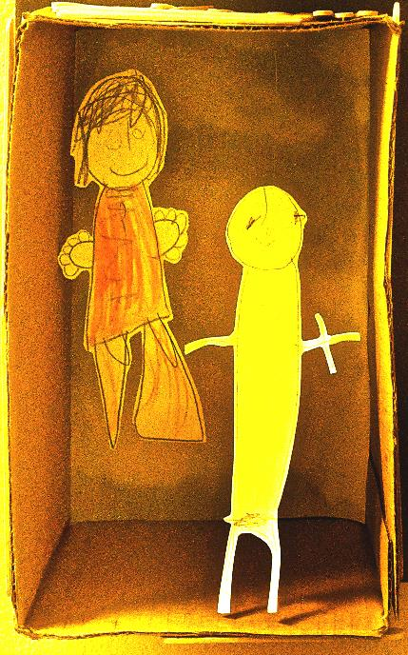
My Brother’s Keeper
In 2014, President Obama launched the “My Brother’s Keeper” Initiative to bridge pervasive opportunity gaps for boys and young men of color.
Key recommendation: “Eliminate Expulsions and suspensions in early childhood settings (provide teacher support)
Acknowledge and address implicit bias
Later that year, HHS and ED released the first ever Federal policy on suspension and expulsion
Notes:
As most of you now know, in 2014, the President launched the My Brother’s Keeper initiative to bridge pervasive opportunity gaps for boys and young men of color. One of the key recommendations in the effort is to eliminate expulsions and suspensions in early childhood settings and to provide early educators with the support they need to prevent these practices- including supports to acknowledge and address implicit biases. Later that year, HHS and ED released the first ever
One of the key recommendations in the effort is to eliminate expulsions and suspensions in early childhood settings and to provide early educators with the support they need to prevent these practices- including supports to acknowledge and address implicit biases.
Later that year, HHS and ED released the first ever Federal policy statement on expulsions and suspensions, with a comprehensive set of recommendations to prevent and eventually eliminate expulsions and suspensions and to build workforce capacity to support children’s social-emotional development and address implicit biases.

Slide 11
The Costs of Preschool Expulsion
Individual, Societal and Monetary Outcomes
Notes:
Preschool behavior problems are the single best predictor of adolescent delinquency and adult imprisonment.
Expulsions deny the child the benefit of continuity of quality early care and education.
Expulsions prevent children from receiving and having access to potentially beneficial mental health services.

Slide 12
Focus of Inquiry: What Does it Take to Help the Child be Successful?
Classroom management
S-E Curriculum
Training and PD
Mental Health Consultation
A clearly defined policy
Systemic care coordination & family support
Notes:
Head Start's policy is to work with the neediest of the needy, to pioneer new strategies for challenges faced by young children and program staff, and
Embrace parents and community partners in the work. Head Start institutes and builds training for teachers, caregivers, and family advocates to succeed rather than give up.

Slide 13
The likelihood of expulsion decreases significantly when teachers have access to classroom-based consultation and support
What does this look like in your classroom?
What kind of support do you find most helpful?

Slide 14
Classroom Based Support Lowers rate of Expulsion

Slide 15
Ecosystemic Perspective
society
community
family
child
Notes:
Systems Approach in Early Care & Learning
A systems approach should support children and teachers, and parents and access additional resources in the community
No more knee jerk reactions
Create your Pyramid
Identify your resources
Identify ways you close the loop for families

Slide 16
Transactional, Interactional & Contextual
Plans & Decisions
Child’s response to strategies
Community Care Licensing
Classroom safety
(Peers and Families’ perspective)
Teacher’s
Stress Level
Family’s level of engagement

Slide 17
Importance of Self-Care in Promoting Self-Regulation
Group Activity
Notes:
Is there where we talk about supporting staff wellness/self-regulation to improve child outcomes? When teachers are well they are more resilient during difficult times, more open to learning and trying new strategies, and are able to view the child and the behavior in a more positive and manageable. When teachers “feel” supported, they feel more capable of managing challenging situations….. This results in better child outcomes and reduces the likelihood of suspension/expulsion

Slide 18
Group Exercise: Review of your program policy addressing suspension and expulsion:
Do you currently have a policy addressing expulsion?
What type of classroom behavioral management trainings are your teachers receiving?
How are you engaging parents in the process?
Do teachers and families have access to mental health consultation? How are you supporting staff wellness?
What are the challenges and barriers you encounter?

Slide 19
Policy Recommendations
A comprehensive discipline policy* that includes:
An explicit description of alternatives to expulsion for children, and should include the program’s protocol for preventing challenging behaviors (Intervention Plan).
Provisions for staff to have access to trainings, MH consultations,
Classroom-based supports and stress managements resources.
Maintain effective positive discipline and support systems to strengthen teachers’ behavior management skills
Parental involvement in the support and intervention plan process
*Caring For Our Children Guidance Handout
Notes:
These policies should be in writing and clearly articulated and communicated to parents/guardians, staff and others. These policies should also explicitly state how the program plans to use any available internal mental health and other support staff during behavioral crises to eliminate to the degree possible any need for external supports (e.g., local police departments) during crises.
Staff should also have access to in-service training, resources, and child care health consultation to manage children’s health conditions in collaboration with parents/guardians and the child’s primary care provider. Programs should attempt to obtain access to behavioral or mental health consultation to help establish and maintain environments that will support children’s mental well-being and social-emotional health, and have access to such a consultant when more targeted child-specific interventions are needed.

Slide 20
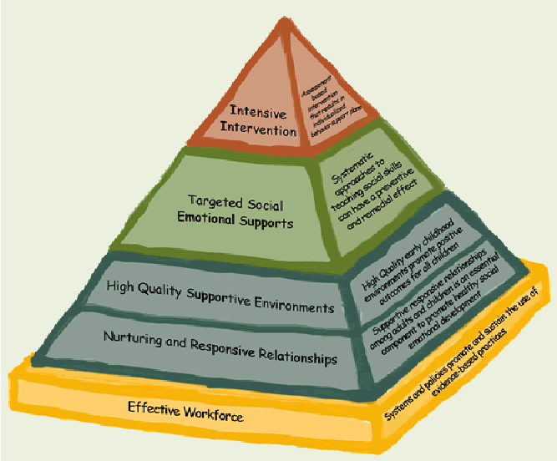
NHA Service Delivery Model
Multi-disciplinary team of Coordinators and Program Specialists.
All Program Specialists are trained to provide mental health support
Mental Health Coordinator
as the “Licensed Mental
Health Professional”
Notes:
Be mindful of what you are asking your teachers to do, is it realistic, do they have the skill set, do they have the support from their team?
We train teachers on the bottom tiers and a little bit on the Targeted Social Emotional Supports (CSEFEL)
Our CACU team implements the Intensive Interventions, with the support of the site staff.
We assign support to the classroom depending on the need- start with the program specialist, add an intern, add OT consultant, add SLP consultant, add Licensed Mental Health Professional

Slide 21
NHA Service Delivery Model
Service Request is submitted
Any decisions regarding variation of attendance or determination of appropriate placement must be approved by the Mental Health Coordinator and the Associate Vice President.
Observations, interview, data collection
Case discussed during Care Coordination
Intervention Plan/ Safety Plan is developed
Referrals made to outside developmental, mental health, and/or parenting programs
Support is added to the classroom
Intervention Plan is Reviewed; strategies are amended
Notes:
Provide SOP’s on Intervention Plans, NAPVAP, and MH table of contents

Slide 22
Case study & Group Activity

Slide 23
Central Focus: Whatever it Takes to Help the Child be Successful (What does this mean?)
To the child? The family?
To the teacher? The classroom
To the site supervisor?
To the program director?
To the Mental Health consultant?
To the support team?
Notes:
Head Start's policy is to work with the neediest of the needy, to pioneer new strategies for challenges faced by young children and program staff, and
Embrace parents and community partners in the work. Head Start institutes and builds training for teachers, caregivers, and family advocates to succeed rather than give up.
Develop and implement policies which support:
Identification and support of social-emotional challenges in children and families.
Parent engagement and social service support
Involvement of MH consultations
Teacher support- teacher wellness
Collaborative engagement with teachers and parents with a multi-disciplinary team approach
Mindfulness in the classroom with teachers and children
Classroom-based mentoring & support
Collaboration with Community MH providers

Slide 24
REFERENCE & RESOURCES
Gilliam, W. S. (2005). Prekindergarteners left behind: Expulsion rates in state prekindergarten systems. New Haven, CT: Yale University Child Study Center.
Perry, D.F, Dunne, M.C., McFadden, L., & Campbell, D. (2008). Reducing the risk for preschool expulsion: Mental health consultation for young children with challenging behaviors. Journal of Child and Family Studies, 17, 44-54.
Bradshaw, C.P., Mitchell, M.M., Leaf, P.J. (2010). Examining the effects of Schoolwide Positive Behavioral Interventions and Supports on Student Outcomes. Journal of Positive Behavior Interventions, 12, 122-48.
Reducing Young Children’s Risk of Behavioral Difficulties in Head Start: Benefits of a Classroom-Based Approach
The Call to End Preschool Expulsion

